Slide 1
Skincare Product Recommendation System
Using Content-Based Filtering with SVM

Slide 2
Problem Statement
Objective:
To create a skincare product recommendation system that suggests relevant products based on user preferences.
Challenges:
  Handling a large dataset with diverse product details and user reviews.
  Preprocessing text-heavy data like product descriptions and reviews.
  Generating personalized product recommendations effectively.

Slide 3
Solution Overview
Approach:
  Implement content-based filtering to recommend products based on features such as name, brand, category, and reviews.
  Use Support Vector Machine (SVM) to classify products and provide suggestions tailored to user inputs.

Slide 4
Dataset Overview
Source: Sephora Product Info and Reviews Dataset
Key Columns:
  Product name, brand, rating, reviews, price, ingredients, categories, etc.
Dataset Characteristics:
  Balanced data with rich textual and categorical features.
  Required preprocessing to handle missing values and textual data.

Slide 5
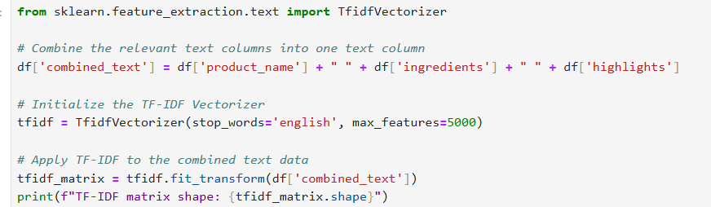
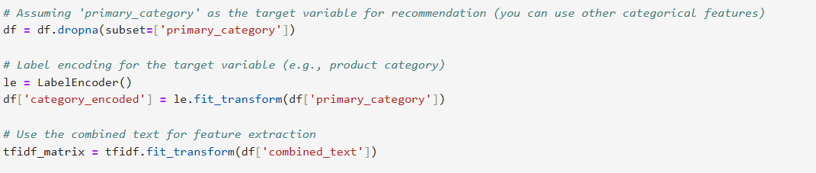
Data Preprocessing
Steps Taken:Handled missing values by filling based on column .
Textual data (e.g., reviews, descriptions) preprocessed using TF-IDF vectorization.
Categorical data encoded using Label Encoding.
Data split into training and test sets for evaluation.

Slide 6
Exploratory Data Analysis (EDA)
Key Insights:Distribution of product ratings: Majority are rated 4 and above.
Popular brands and categories (e.g., moisturizers, face washes).
Price distribution shows a mix of budget and premium products.
Visualizations:
  Bar charts for category popularity.
  Histograms for price and rating distributions.

Slide 7
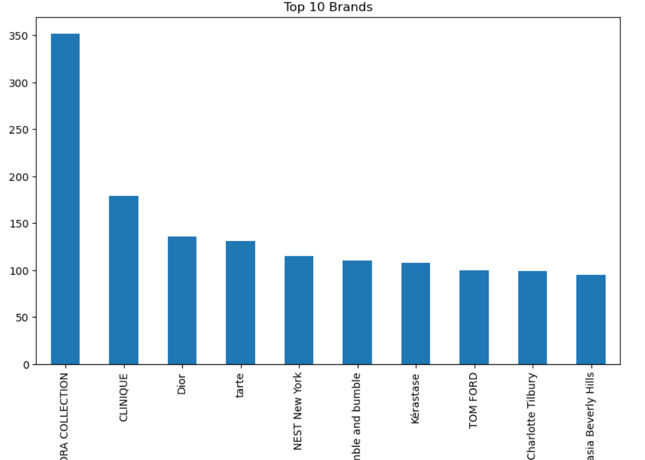
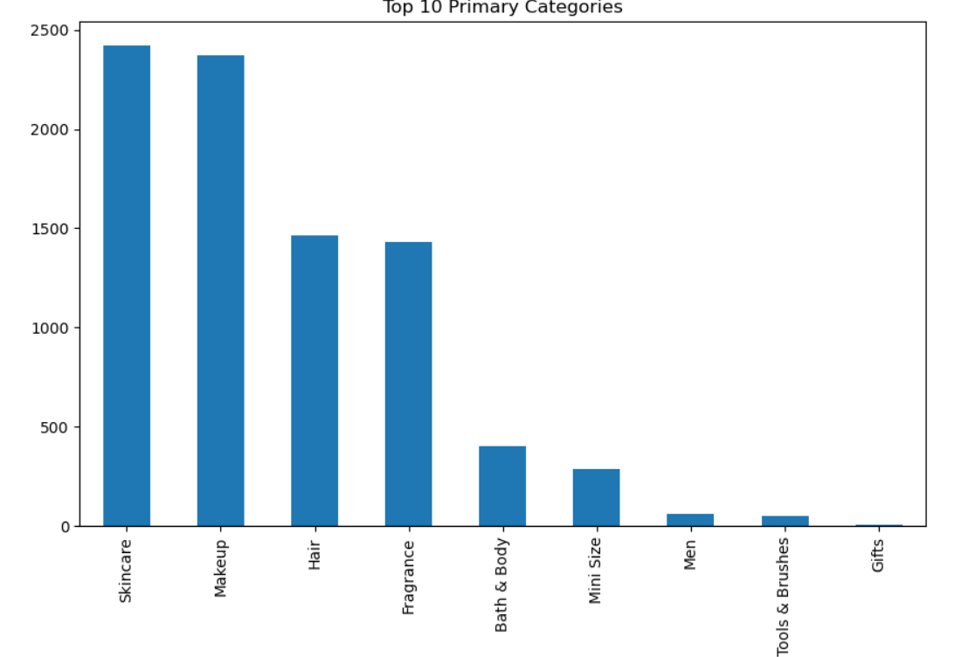
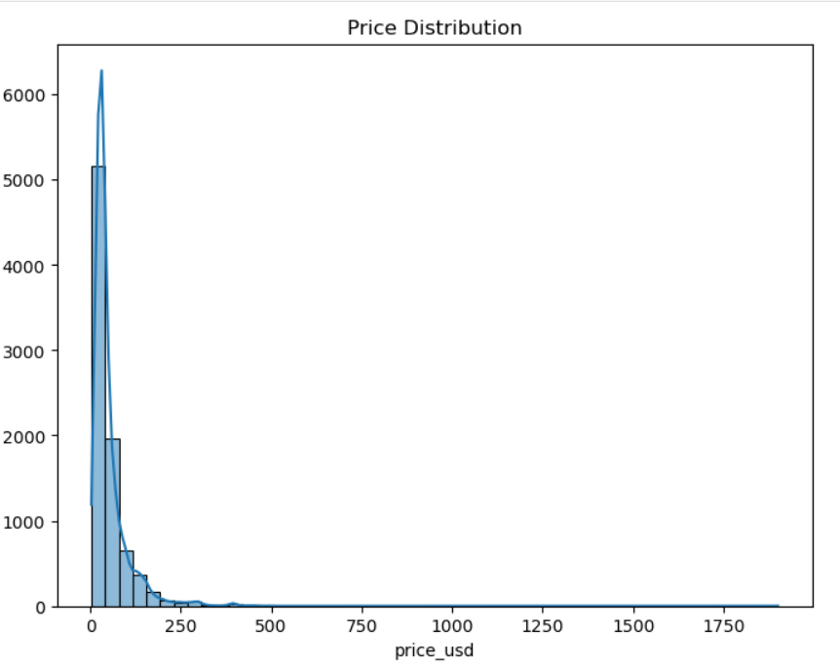
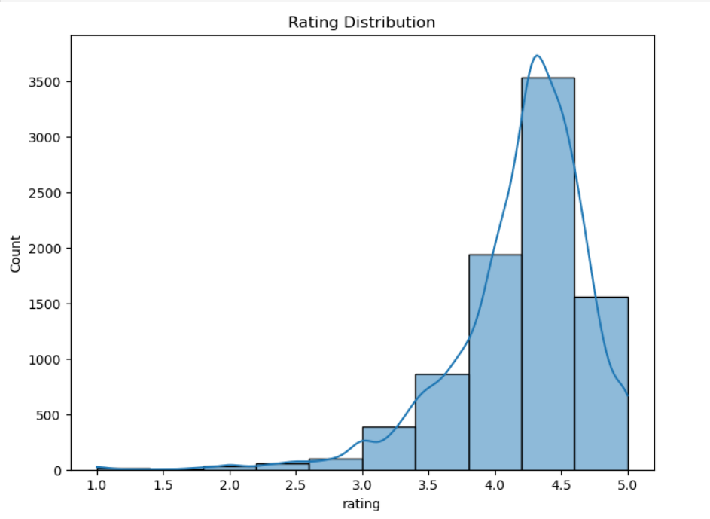

Slide 8
Model Selection
Choice of Model: Support Vector Machine (SVM) with a linear kernel.
Why SVM?:
Excellent performance in high-dimensional spaces (e.g., TF-IDF features).
Clear decision boundaries for classification tasks.
Other Considered Models: K-Means Clustering and Decision Trees, but SVM provided the best accuracy.

Slide 9
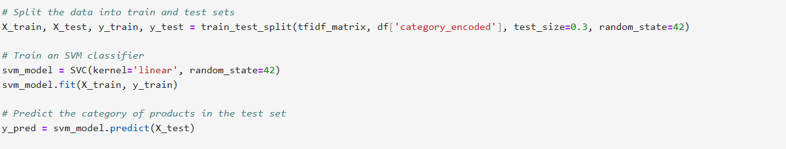
Model Training
  Preprocessing for SVM:
Used TF-IDF vectorization for textual data.
Encoded categorical features with Label Encoding.
Split dataset into training (80%) and testing (20%).
Model Details: SVM with a linear kernel for classification.

Slide 10
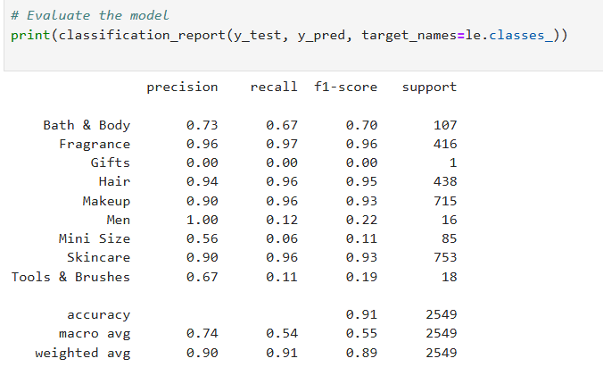
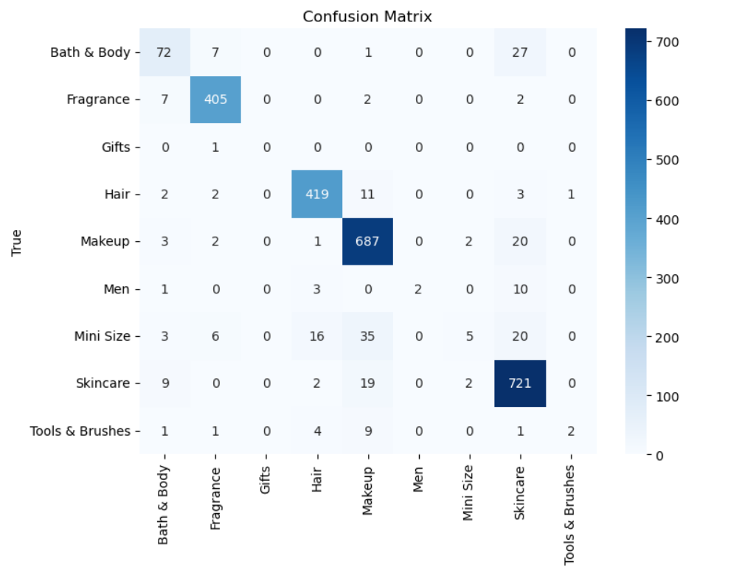
Model Evaluation
Performance Metrics:
  Accuracy: 90.74%
  Precision: 73.89%
  Recall: 53.52%
  F1-Score: 55.44%
  ROC AUC: 76.08%
Conclusion:
  The model performs well overall, with high accuracy and reasonable precision.

Slide 11
User Input for Recommendations
How It Works:
  User Input: Enter preferences like product category, price range, or brand.
  System Output:
    Returns a list of recommended products with details like descriptions, ratings, and prices.
Example
User Input:
  "Looking for an affordable moisturizer under ₹500."
System Output:
  Product 1: "Brand A Moisturizer - ₹450, Rating: 4.5"
  Product 2: "Brand B Moisturizer - ₹480, Rating: 4.2"

Slide 12
Conclusion
Key Takeaways:
Successfully developed a content-based skincare recommendation system using SVM.
Achieved high accuracy with relevant product suggestions.
Future improvements will enhance system performance and user experience.

Slide 13
THANKYOU

